Slide 1
Tools for Citywide Inclusive Sanitation
An overview
Version 1: October 2023
Notes:
Reading Materials:
https://www.ircwash.org/blog/integrated-waste-management-assessment-and-planning
https://www.sciencedirect.com/science/article/pii/S0301479723011532?via%3Dihub

Slide 2
Purpose of this deck
Plenty of decision support tools (DSTs) exist in public domain, often leading to confusion among decision makers on which tool to use for assessment, planning or monitoring.
This deck compiles all publicly available decision support tools that aid assessment and planning for safely managed sanitation.
It provides an overview of the tools, with key information for each to guide readers to select relevant tools and includes links to the tool and supporting reading materials/case studies.
Key inclusion considerations for tools in this review:
Initial list of tools screened from literature review (publication 1, publication 2)
Only tools for wastewater management are considered i.e. those for solid waste management or water supply are excluded.
Tools in the form of an ‘approach’ are not included.
Notes:
Publication 1: https://www.researchgate.net/publication/372360347_Exploring_the_usage_and_impact_of_urban_sanitation_tools_targeting_low-_and_middle-income_countries
Publication 2: https://www.sciencedirect.com/science/article/pii/S0301479723011532?via%3Dihub

Slide 3
Classification of Tools
User Interface
Containment
Collection and Conveyance
Treatment
Reuse and Disposal
City Service Delivery Assessment
CWIS Costing & Planning Tool
SaniPath
SaniPlan
Santiago
Citywide & Regional Planning Tool
Business Model Tool
EquiServe & Rapid Equity Analysis Model
WASHBAT
Sustainable Sanitation Management Tool
SaniTech
MUSE
CWIS Measurement Tool
Akvopedia
Faecal Waste Flow Calculator
WASH Cost Tool
Cactus
Shit Flow Diagram
Rapid Assessment Tool
Urban Sanitation Status Index (USSI)
Rapid Environment Assessment Tool
Toilet Resource Calculator
CLARA-SPT
ECAM
Simba
Bio WATT
Ease Tech
EVAS
Fit Water
Poseidon
Sampsons
West+
Tech Select

Slide 4
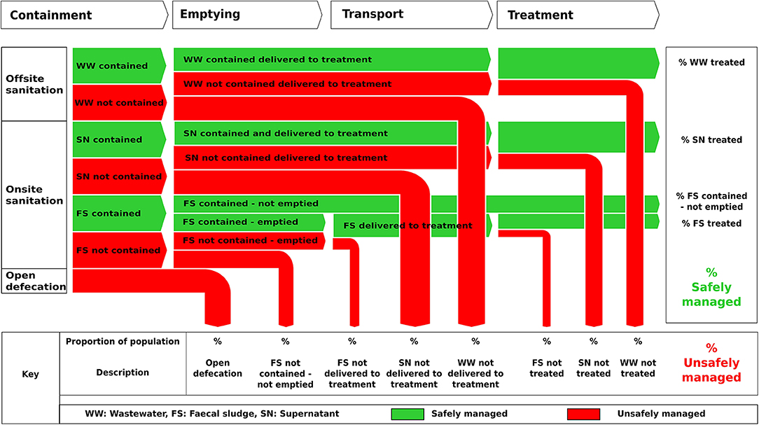
Shit Flow Diagram (SFD)
Developed by: | Sustainable Sanitation Alliance (SuSanA) – Consortium under SFD Promotion Initiative.
Year of development: | 2014
Last updated: | 2022
Tool format: | Online graphic generator and desktop version available.
Waste streams covered: | Wastewater (Supernatant, Sewage and Faecal Sludge).
Value chain segment: | Containment, Collection and Conveyance, Treatment
Primary users: | Gov. stakeholders and development sector partners (technical assistance partners to Gov. including consultants, NGOs, Academics, etc.).
Data Requirements:
Types of containment unit and where it is connected to; Population dependent on each category; % of OSS emptied; % FS, WW, SN reaching treatment plant; % FS, WW, SN treated.
Training Materials:
SFD Manual
SFD Report Template
SFD Report Guidance Note
Online Training
Case Studies: Click here to access SFDs worldwide.
About the Tool:
A Shit Flow Diagram (SFD) serves as a practical tool for comprehending and conveying the physical flow of excreta within a city or town. It visually illustrates the journey of excreta, highlighting whether it remains contained or not, as it follows various routes from defecation to disposal or utilization.
An SFD is essentially a visualization tool that simplifies intricate data into an accessible diagram. It is usually accompanied by a description of the service delivery context and details regarding data sources within the relevant city.

Slide 5
Rapid Assessment Tool
Developed by: | IRC WASH
Year of development: | 2015
Tool format: | Excel spreadsheet, available online for free
Waste streams covered: | Wastewater; (Faecal sludge; Blackwater; Greywater; Septage; Excreta)
Value chain segment: | Containment, Collection and Conveyance, Treatment and Disposal
Primary users: | WASH practitioners, policymakers, and donors.
About the Tool :
A spreadsheet-based tool for calculating the quantitative flows of faecal sludge through various sections of an urban area. IRC tool enables a rapid assessment to gauge the current and potential supply and demand for sanitation in a specific area. It focuses on affordability, packaging, marketing, and accessibility to meet diverse sanitation needs.
The assessment combines consumer and market research, considering Price, Product, Promotion, and Place. Results are visualized using a 'traffic light' system: Green lights (75% or more balance) indicate no immediate concerns. Yellow lights (50% to 75% balance) highlight areas for attention after addressing red light issues. Red lights (less than 50% balance) require immediate attention and further analysis. Insights from this assessment inform recommendations to improve sanitation facilities and services.
Case Studies:
Sanitation market research in rural Cambodia : rapid assessment of supply and demand in three rural districts
Data Requirements:
Overall, the tool requires data on the following -
Who are the customers and the supply side actors?
Price: how much can they afford and how much does it cost?
Products: what is needed and what is made available?
Promotion: are products promoted
Place: where are the customers and the supply side actors?
Do they have the knowledge to decide or to advise?
Detailed information is required on aspects related to water supply (availability of drinking water, access to water for sanitation, water quality), sanitation demand (access to sanitation facilities, sanitation practices) and sanitation service provision (type of sanitation facilities available, level of service provision, cost of sanitation services). The full questionnaire can be found here.
Training Resources: Click here.

Slide 6
City Service Delivery Assessment (CSDA)
Developed by: | World Bank
Year of development: | 2013
Tool format: | Available in spreadsheet format and web-based format.
Waste streams covered: | Wastewater (Blackwater and Greywater) – Sewered and Non-sewered Sanitation.
Value chain segment: | User Interface, Containment, Collection and Conveyance, Treatment, Disposal and Reuse.
Primary users: | Consultants, facilitators or in-house specialists as a participatory tool for working with stakeholders in cities and towns.
Data Requirements:
Data related to enabling environment including policy, legal and institutional environment, resources and mechanisms available to improve sanitation, operating environment, funding and personnel availability to provide ongoing and sustainable sanitation services.
The full questionnaire can be found here.
Training Resources: Click here.
Contact: Peter Hawkins and Isabel Blackett on ISP@incsanprac.com
About the Tool :
CSDA is a comprehensive tool that assesses the environment for inclusive sanitation, supports stakeholder engagement, and provides a roadmap for improving sanitation services in both sewered and non-sewered contexts. The tool supports the assessment of the enabling environment for City-wide Inclusive Sanitation using a series of structured questions.

Slide 7
SaniPath
Developed by: | Center for Global Safe WASH at Emory University
Year of development: | 2011
Tool format: | Available online, can be accessed from here.
Waste streams covered: | Wastewater.
Value chain segment: | Containment, Collection and Conveyance, Treatment, Disposal and Reuse.
Primary users: | WASH practitioners from the academia, consultancy, local and national government, INGO/NGO, private sector and financial institutions.
About the Tool :
The SaniPath Exposure Assessment Tool (“the Tool”), was developed by the Center for Global Safe WASH at Emory University to identify and compare risk of exposure to fecal contamination across multiple exposure pathways associated with inadequate sanitation and fecal sludge management.
The assessment combines consumer and market research, considering Price, The Tool provides guidance for standardized primary data collection, automates the exposure assessment analysis, and visualizes the results in a way that is accessible and understandable to people with a variety of backgrounds. It enables users to develop a robust evidence base for advocacy and decision making in the WASH sector.
The platform is integrated with KoBo Toolbox and data are collected via downloadable mobile forms and uploaded to a SaniPath server. An analytical dashboard automatically retrieves data from the server and performs the exposure analysis on a daily basis. From the dashboard, the user can view pie charts, histograms, and People Plots and automatically generate a draft final report
Data Requirements:
Environmental samples are collected from each exposure pathway (surface water, municipal water, flood water, open drains, etc.). Ten samples are collected from each pathway in every neighborhood where the SaniPath Tool is deployed.
Environmental samples are processed in a laboratory to determine the magnitude of fecal indicator bacteria (E. coli) in each sample.
Behavioral data is collected via surveys at the community, school, and household levels. This data captures the frequency of exposure-related behaviors for both adults and children.
Training Resources: Background information and procedures for conducting the preliminary assessment; behavioral survey procedures; environmental sampling procedures.
Case Study: Ghana 1, Ghana 2, Lusaka, Dhaka.

Slide 8
Urban Sanitation Status Index (USSI)
Developed by: | World Bank
Year of development: | 2015
Tool format: | Scorecard -based
Waste streams covered: | Faecal waste.
Value chain segment: | Containment, Collection and Conveyance, Treatment, Disposal.
Primary users: | Development sector partners (technical assistance partners to Gov. including consultants, NGOs, Academics, etc.).
About the Tool :
The Urban Sanitation Status Index (USSI) is a tool developed by the World Bank to assess the overall status of urban sanitation in a given city or country. It is a composite index that takes into account a number of factors, including Access to improved sanitation facilities, Adequacy of sanitation facilities, Safety of sanitation facilities, Sustainability of sanitation services
The USSI is calculated on a scale of 0 to 100, with higher scores indicating better sanitation status.
Data Requirements:
Access to Infrastructure; type of on-site sanitation system; containment Safety; structural stability of the facility; groundwater level; soap and water availability nearby for handwashing; access to emptying services; amount of fecal waste transported to WWTP; quality of disposal management; access to water supply; water availability for flushing and cleaning and solid waste management; in-house greywater management.
Case Studies:
EAWAG ConCad Series
Maputo, Mozambique

Slide 9
Faecal Waste Flow Calculator
Developed by: | IRC WASH
Year of development: | 2015-2016
Tool format: | Excel file format, can be accessed from here.
Waste streams covered: | Faecal sludge
Value chain segment: | Containment, Collection and Conveyance, Treatment and Disposal, Reuse
Primary users: | Engineers, planners and decision makers to get a better understanding of the current situation in a city.
About the Tool :
The tool calculates volumes of faecal waste as well as faecal sludge volumes and assesses what needs to be in place for safe sanitation service provision. The volumes of faecal waste lost between each of the six links in the sanitation chain: capture, containment, emptying, transport, treatment, and safe use or disposal is the main focus of the tool since this will be the main aspect which affects public health and will therefore be of the greatest importance.
Case Studies:
Indonesia
India
Data Requirements:
City-wide information on population size, number and types of toilets, information on pit emptying and transportation methods, on treatment plant type and capacity. The questions on capture and containment take residents as well as temporary residents into account.

Slide 10
WASH Cost
Developed by: | IRC WASH
Year of development: | 2008
Tool format: | Web-based tool, available online for free
Waste streams covered: | Water and Faecal waste
Value chain segment: | Containment, Collection and Conveyance, Treatment, Disposal and Reuse.
Primary users: | Consultants, facilitators or in-house specialists as a participatory tool for working with stakeholders in cities and towns
About the Tool :
The WASH Cost aims to analyze the costs of water, sanitation, and hygiene (WASH) services in rural and peri-urban areas without utility coverage. It addresses the lack of data regarding these costs and emphasizes the importance of funding recurrent expenditures for sustainable service delivery.
Case Studies:
WASH Cost Burkina Faso, WASH Cost Ghana, WASH Cost Mozambique and WASH Cost Andhra Pradesh (India).
Data Requirements:
Data related to enabling environment including policy, legal and institutional environment, resources and mechanisms available to improve sanitation, operating environment, funding and personnel availability to provide ongoing and sustainable sanitation services.
Training Resources
http://moodle.ircwash.org/

Slide 11
CLARA Planning tool
Developed by: | BOKU University of Natural Resources and Life Sciences, Vienna
Year of development: | 2014
Tool format: | Excel spreadsheet, available online for free
Waste streams covered: | Water and Wastewater
Value chain segment: | Collection and Conveyance, Treatment and Disposal
Primary users: | WASH practitioners, policymakers, and donors.
Data Requirements:
Data required related to investment, operation and maintenance, and re-investment costs of various water supply and sanitation systems. Using the cost data Net present values of all costs are calculated and used for comparison.
Training Resources:
About the tool.
Tool manual
About the Tool :
The CLARA Simplified Planning Tool (SPT) is a software tool that helps local planners find the best solution for water supply and sanitation interventions. The SPT is based on a number of assumptions, which allow the planner to use the tool with a limited amount of data available at the pre-planning phase of a project. It can be used to compare the costs of different water and sanitation systems without having to conduct detailed feasibility studies.
Case Studies:
Here the application of the SPT in Arba Minch, Ethiopia is shown: Ketema, A.A. (2015): Adapting and applying a simplified WASH planning tooll for cities in Ethiopia - Chapter 6: Water supply and sanitation systems pre planning and CLARA Simplified Planning Tool application. PhD thesis, BOKU University Vienna, Austria, pp.102-130.
Shows cost functions for Ethiopia developed from real costs: Ketema, A.A., Lechner, M., Tilahun, S.A., Langergraber, G. (2015): Cost function development for Life Cycle Cost based water supply and sanitation system planning, Case study of Bahir Dar & Arba Minch, Ethiopia. Journal of Water, Sanitation and Hygiene for Development 5(3), 502-511.
Compares cost functions with results from the SPT: Ketema, A.A., Langergraber, G. (2016): Statistical validation of the CLARA Simplified Planning Tool. Water Sci Technol: Water Supply 16(1), 193-201.

Slide 12
CWIS Costing and Planning Tool
Developed by: | World Bank
Year of development: | 2018
Tool format: | Online tool can be accessed from here
Waste streams covered: | Wastewater
Value chain segment: | User Interface, Containment, Collection and Conveyance, Treatment and Disposal, Reuse
Primary users: | Consultants and Researchers supporting government in decision making
About the Tool :
CWIS principles challenge decision makers to prioritize sanitation investments that will provide access to safely managed sanitation services for all inhabitants of a city. After assessing existing sanitation service coverage, as part of the process of comparing different potential sanitation solutions, it is important to consider the comparative financial capital and operational costs of different options. This tool aims to help perform that analysis and compare different technical solutions based on their comparative costs.
Data Requirements:
# of HHs, description of sanitation system, investment cost (capital and operational) for a particular sanitation component/technology disaggregated by main parts and life span.
Training Resources: Click here.

Slide 13
SaniPlan
Developed by: | CEPT University
Year of development: | 2016
Tool format: | Excel spreadsheet, available online for free
Waste streams covered: | Faecal sludge
Value chain segment: | User Interface, Containment, Collection and Conveyance, Treatment, Disposal and Reuse.
Primary users: | Gov. stakeholders and development sector partners (technical assistance partners to Gov. including consultants, NGOs, Academics, etc.). ​
About the Tool :
SANIPLAN is a decision support tool that provides a structured approach in planning for urban sanitation. It focuses on integrated service performance with a detailed assessment of finances. It is a planning tool which can support more informed stakeholder participation. Based on local priorities users can identify key actions for service improvement and prepare a Financing Plan that ensures funding for both capital and operating expenditure.
Case Studies: Sinnar, Wai.
Data Requirements:
City-wide information on population size, number and types of toilets, information on pit emptying and transportation methods, on treatment plant type and capacity. The questions on capture and containment take residents as well as temporary residents into account.
Training Resources:
Guidance Note
Approach Paper
Step by Step Guide

Slide 14
Santiago
Developed by: | Spuhler and others
Year of development: | 2020
Tool format: | Excel spreadsheet, software (SANitation sysTem Alternative GeneratOr),available online for free
Waste streams covered: | Wastewater
Value chain segment: | User interface, collection and conveyance, treatment, disposal and reuse
Primary users: | Development sector partners (technical assistance partners to Gov. including consultants, NGOs, Academics, etc.).
About the Tool :
A tool with a systematic procedure for generating a manageable set of sanitation system options and quantifying resource recovery potential as input to structured decision-making processes.
Data Requirements:
Water supply (which water supply options are available), Energy supply (is energy supply available in the application case), Frequency of operation and maintenance (O&M), What is the min., mean, max. average monthly temperatures? What is the flooding risk for the area? How accessible are the plots? To what extent are the skill levels locally available? Are there drinking water sources closer than 30 m from point of infiltration? Etc.
Training Resources:
Detailed research
Publication

Slide 15
Citywide & Regional Planning Tool, FSM Toolbox
Developed by: | FSM Alliance
Year of development: | 2019
Tool format: | Web-based tool, available online for free. Click here.
Waste streams covered: | Faecal sludge
Value chain segment: | User interface, Collection and Conveyance, Treatment, Disposal and Reuse.
Primary users: | City and regional planners, sanitation engineers, and other professionals involved in the planning and implementation of FSM systems.
About the Tool:
The Toolbox by FSMA is a web platform with a suite of tools and resources designed to assist and guide anyone interested in undertaking assessments and planning infrastructure improvements.
Within the FSM Toolbox platform, the infrastructure planning toolkit assists users estimate infrastructure gaps and identify responses for improvement. There are two components under this product – Citywide Planning (which helps you plan infrastructural improvements for your city) and Regional Planning (helps you plan for a region or a cluster of cities).
Training materials:
Citywide Planning Tool
Regional Planning Tool
Data Requirement: City-wide information on population size, number and types of toilets, information on pit emptying and transportation methods, on treatment plant type and capacity. The questionnaire is split across households, community toilets, public toilet, commercial and institutional buildings, treatment plant and desludging operators.
For regional planning, the tool requires data on GPS location of city, distance desludging operators are willing to travel, volume of faecal sludge generated, availability of sewage treatment plant/faecal sludge treatment plant and available capacity, utilization capacity of treatment plant, etc.
Detailed questionnaire is available here.

Slide 16
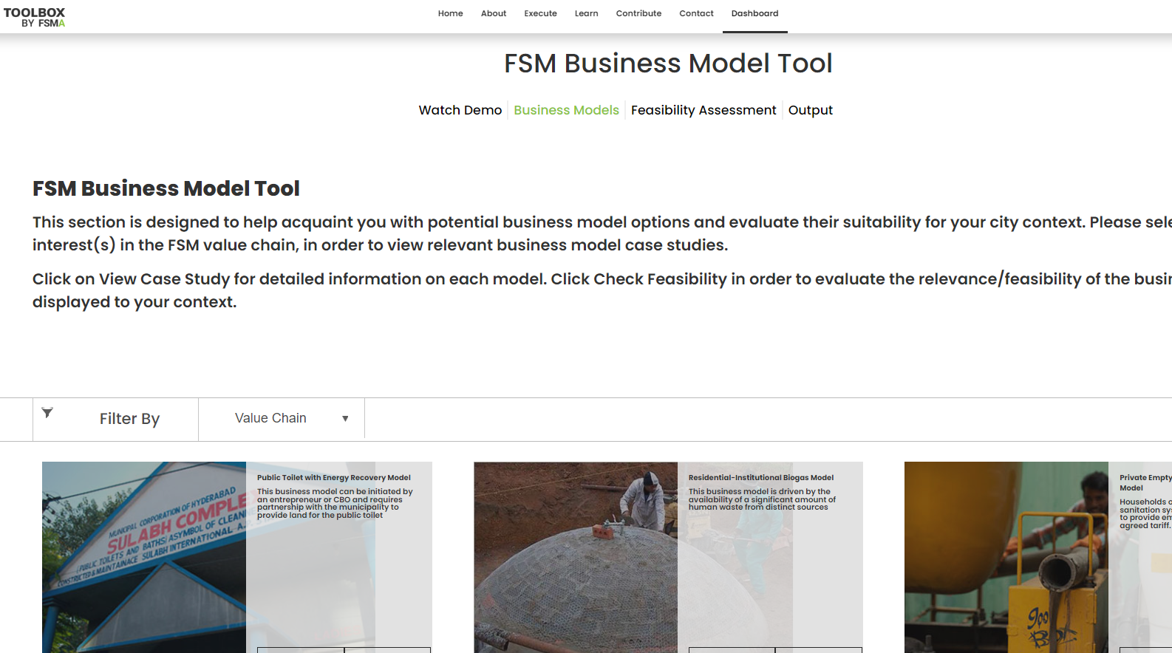
Business Model Tool, FSM Toolbox
Developed by: | FSM Alliance – IWMI and Athena Infonomics
Year of development: | 2019
Tool format: | Web-based tool, available online for free. Click here.
Waste streams covered: | Faecal sludge
Value chain segment: | User interface, Collection and Conveyance, Treatment, Disposal and Reuse.
Primary users: | Private entrepreneurs, City and regional planners, sanitation engineers, and other professionals involved in the planning and implementation of FSM systems.
About the Tool:
The Toolbox by FSMA is a web platform with a suite of tools and resources designed to assist and guide anyone interested in undertaking assessments and planning infrastructure improvements.
Within the FSM Toolbox platform, the business model tool presents case studies on a range of business models implemented in different parts of the world across the FSM value chain, referenced from IWMI’s Resource Recovery and Reuse Series 6 document. It also goes on to assist users evaluate the relevance of these different models to their context.
Training materials: Click here.
Data Requirement: Regulatory and institutional structures which forms the enabling environment for sustaining a business model. To check the feasibility of a business model, the user needs to enter simple Yes or No answers for the existing regulatory and institutional structures.
Detailed questionnaire is available here.

Slide 17
EquiServe & Rapid Equity Analysis Model
Developed by: | Athena Infonomics
Year of development: | 2019
Tool format: | Web-based tool, available online for free. Click here. A Rapid version of the tool (Rapid Equity Analysis) is available in an excel file format. Click here.
Waste streams covered: | Wastewater
Value chain segment: | User interface, Collection and Conveyance, Treatment, Disposal and Reuse.
Primary users: | Public Service Authority/Regulator
About the Tool:
EquiServe is a powerful analytical engine that can provide a range of insights to guide public sector leaders and development actors to explore a range of levers to advance safe access and do more with less & reach the poor.
Equiserve is a scenario planning tool designed to facilitate evidence-based coordinated action on sanitation service improvements. It helps assess the service system, test different service improvements and visualize tradeoffs
Training materials:
Tool user guide
Data manual
Session 1, Session 2, Session 3
Rapid Equity Analysis Visual
Data Requirement: City Sanitation Coverage; Service Delivery Mapping; Hardware Details; Tariff details; Capital and Operating Costs; Funding source; etc.
Detailed questionnaire is available here.
Case Studies: Lusaka, Zambia; Kampala, Uganda; Zambia; Tema, Ghana; Haiti

Slide 18
WASHBAT
Developed by: | UNICEF
Year of development: | 2012 (first version released)
Tool format: | Online tool, can be accessed from here.
Waste streams covered: | Water and Wastewater
Value chain segment: | User interface, Collection and Conveyance, Treatment, Disposal and Reuse.
Primary users: | Consultants, researchers and decision makers.
About the Tool:
The WASH Bottleneck Analysis Tool (WASH BAT) is designed to support the drinking water, sanitation and hygiene (WASH) sector, by enabling the formulation of costed and prioritized plans to remove the bottlenecks that hinder progress.
Analyzes the complex interplay of institutional structures and processes that determine how effectively human, material and financial inputs are turned into sustainable access to drinking-water supply and sanitation. Provides a rational evidence-based approach for formulating an investment strategy for multiple sector aims of efficiency, equity and sustainability.
Case Studies: Bangladesh, Ecuador, Pakistan.
Data Requirement: Select sub-sector (water, sanitation, hygiene and WASH in Institutions), add participants to the group, select building blocks (policy, institutional arrangements, financing, planning, monitoring and reviewing, capacity development, etc.), conduct bottleneck analysis (select criteria, identify bottleneck and its cause, manage activity for bottleneck removal), for the activity identify reason, timing, priority, funding and allocation of funds, assigning responsibility.
Reference Materials: User Guide, Brochure, Tutorial, Summary Guide, Country Implementation Guide.
Training Materials: Click here.

Slide 19
Sustainable Sanitation Management Tool
About the tool: | The SSWM Toolbox is the most extensive collection of knowledge around sustainable sanitation and water management. It compiles thousands of “best of“ instruments – be that technologies, methodologies, behavioural change approaches or planning tools – geared to optimise sanitation and water management intervention at local level all curated in an easy-to-understand yet comprehensive way.
Developed by: | Seecon in collaboration with partner organisations
Year of development: | 2018
Tool format: | Web-based tool platform available for free
Waste streams covered: | Water and Wastewater
Value chain segment: | User interface, collection and conveyance, treatment, disposal and reuse
Primary users: | Sanitation practitioners, policymakers, and donors
Data requirements: | Not applicable
Toilet Resource Calculator
About the tool: | This tool is designed for cities, governments, plantations and factories to assess the benefits of implementing circular sanitation by calculating the potential amount of fuel, fertilizer, feed or water produced from the Toilet Resources of a community. After the initial calculation, select a specific product to be connected to entrepreneurs producing the product.
Developed by: | Toilet Board Coalition
Year of development: | 2019
Tool format: | Web-based tool, available online for free. Click here.
Waste streams covered: | Blackwater (Excreta)
Value chain segment: | Reuse
Primary users: | WASH practitioners
Data requirements: | Amount of people living within a community/city, the time period one would like to calculate for, and user behaviour – community uses toilet paper (Wipe) or water (Wash).

Slide 20
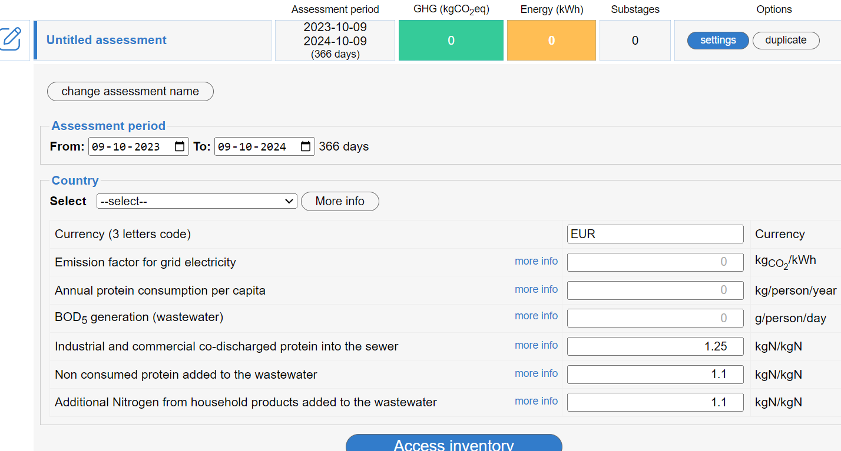
ECAM
Developed by: | Deutsche Gesellschaft für Internationale Zusammenarbeit (GIZ), International Water Association and The Catalan Institute for Water Research (ICRA)
Year of development | 2017
Tool format: | Online tool can be accessed from here
Waste streams covered: | Wastewater (Sewage sludge; Faecal sludge; Urine; Faeces)
Value chain segment: | Collection and Conveyance, Treatment and Disposal
Primary users: | ECAM is meant for water and wastewater utility managers, technicians, consultants, climate change experts, academics and policy makers working on issues regarding water, energy and climate change.
Data Requirements:
Fuel type, Pump type, Pump size, EFCH4 for type of water body/sewer/treatment, type of onsite treatment, N2O EF plants, WW treatment organics removal fractions (centralised and onsite), sludge characteristics in each stage of the treatment process, type of sludge disposed, type of faecal sludge, type of landfill, soil type, type of containment.
Training Resources:
Methodology guide
User Manual
About the Tool :
Energy Performance and Carbon Emissions Assessment and Monitoring (ECAM) Tool assesses greenhouse gas emissions and energy consumption or intensity of the urban water cycle that are within the operational boundaries of water and wastewater companies to highlight emission reduction opportunities and prepare these utilities for future reporting needs on climate mitigation. More details can be found here.
Case Studies: Click here.

Slide 21
Sanitech
Developed by: | CSTEP
Year of development: | 2015
Tool format: | Web-based tool, available online for free
Waste streams covered: | Faecal Sludge
Value chain segment: | User Interface, Containment, Collection and Conveyance, Treatment and Disposal.
Primary users: | Gov. stakeholders and development sector partners (technical assistance partners to Gov. including consultants, NGOs, Academics, etc.). ​
About the Tool :
It is a decision support tool that will help cities in India to provide cost-effective and sustainable sanitation options for all, especially the urban poor, through an integrated framework for assessment of different sanitation options. The tool is envisioned to provide stakeholders information and knowledge of existing and new technologies in a manner that allows them to compare options, assess cost/benefits and make informed decisions.
Data Requirements:
Capital and Operational Expenditure, Land requirement, Groundwater level constraint, Soil type suitable for each sanitation technological option.
Training Resources:
Compendium of technology options
SaniTech Manual
2.

Slide 22
Biogas Wastewater Assessment Technology Tool (BioWATT)
Developed by: | Global Methane Initiative (GMI) and World Bank
Year of development: | 2016
Tool format: | Excel spreadsheet, available online for free
Waste streams covered: | Wastewater
Value chain segment: | Treatment
Primary users: | Consultants and Researchers supporting government in decision making
About the Tool :
The Biogas Wastewater Assessment Technology Tool (BioWATT) provides a quick and preliminary assessment of wastewater-to-energy projects. Through BioWATT, users can receive a specific summary of their biogas production estimates for various wastewater-to-energy technologies, electricity generation potential from the produced biogas, greenhouse gas savings associated with biogas-generated electricity, and more.
Data Requirements:
Hydraulic load and inflow BOD concentration of WW entering treatment plant, Local GHG emissions for electricity generation, availability of UASB/anaerobic pond for collecting biogas, electricity tariff, sludge disposal unit cost, labor cost, etc.
Training Resources:
User Manual
User Guide
Biogas Wastewater Assessment Technology Tool (BioWATT) – Presentation

Slide 23
EaseTech
Developed by: | Technical University of Denmark
Year of development: | 2021
Tool format: | Web-based tool, available via licensing
Waste streams covered: | Wastewater
Value chain segment: | Treatment
Primary users: | Researchers, consultants, authorities as well as technology developers, but only after proper training in the use and interpretation of the model.
About the Tool :
The primary aim of EASETECH is to perform life cycle assessment (LCA) of complex systems handling heterogeneous material flows. EASETECH models resource use and recovery as well as environmental emissions associated with environmental management in a life-cycle context.
http://www.easetech.dk/model-description
Case Studies: Click here.
Data Requirements:
Energy usage, FeCl2 use, NaOH use, N/Zn/Cu/Hg discharge to sea, sludge water content, N2O emission to air, methane leakage, heat substitution, EBP2R/PhBR energy use, N/P fertilizer substitution, etc.,
Training Resources: Click here.

Slide 24
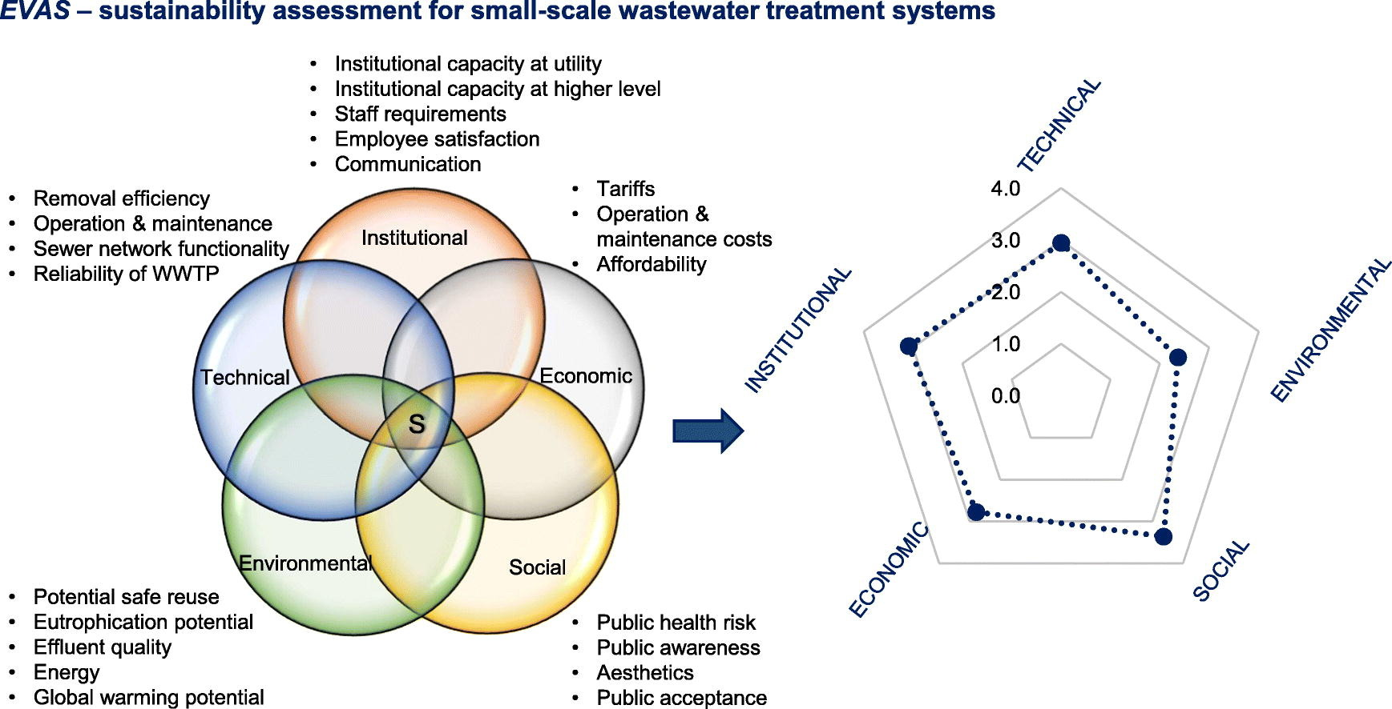
EVAS
Developed by: | World Bank
Year of development: | 2018
Tool format: | Excel based tool can be accessed from here
Waste streams covered: | Wastewater
Value chain segment: | Treatment
Primary users: | WASH practitioners/decision makers working towards the selection of technology, developing engineering DPRs
About the Tool :
A spreadsheet-based tool for assessing the sustainability of small wastewater treatment systems. The EVAS tool can provide managers of small WWTSs in low and lower-middle income countries with the means to identify weaknesses in the management of their systems, and to better understand the needs of the WWTS in their endeavour to achieve improved performance and sustainability. More details can be found here.
Case Studies:
LMICs
Cochabamba, Bolivia
Bolivia
LMICs 2
Data Requirements:
Technical dimension (removal efficiency, operation and maintenance, sewer network functionality, reliability of the WWTP), Environmental dimension (potential safe reuse, eutrophication potential, effluent quality, energy, global warming potential), Social dimension (public health risk, public awareness, aesthetics, public acceptance), Economic dimension (tariffs, operation and maintenance costs, affordability), Institutional dimension (institutional capacity, staff requirements, employee satisfaction, communication).

Slide 25
Feasible
About the tool: | A software tool developed to support the preparation of environmental financing strategies for water, wastewater and municipal solid waste services.
Developed by: | Ministry of the Environment, Denmark & OECD
Year of development: | 2004
Tool format: | Data not available
Waste streams covered: | Water, Wastewater and Solid Waste Management
Value chain segment: | Data not available
Primary users: | Data not available
Data requirements: | Data not available
FitWater
About the tool: | A tool developed to support fit-for-purpose wastewater treatment trains by assessing alternative WWT trains and water reuse applications. Further details can be found here (resource 1, resource 2)
Developed by: | University of British Columbia
Year of development: | 2017
Tool format: | Data not available
Waste streams covered: | Wastewater
Value chain segment: | Treatment
Primary users: | WASH practitioners/decision makers working towards the selection of technology, developing engineering DPRs.
Data requirements: | Amount of reclaimed water production, health risk of water reuse, cost, energy use, and carbon emissions.

Slide 26
Poseidon
Developed by: | Oertlé, Emmanuel; Hugi, Christoph; Wintgens, Thomas; Karavitis, Christos A., with funding from EU
Year of development: | 2018
Tool format: | Excel-based tool can be accessed from here
Waste streams covered: | Wastewater
Value chain segment: | Treatment
Primary users: | WASH practitioners/decision makers working towards the selection of technology, developing engineering DPRs.
About the Tool :
Poseidon is a user-oriented, simple and fast Excel-Tool which aims to compare different wastewater treatment techniques based on their pollutant removal efficiencies, their costs and additional assessment criteria. Poseidon can be applied for pre-feasibility studies in order to assess possible water reuse options and can show decision makers and other stakeholders that implementable solutions are available to comply with local requirements.
Data Requirements:
Data not available
Training Resources: Click here.
Case Studies:
Resource 1
Resource 2
Resource 3

Slide 27
Sampsons
About the tool: | A tool used to visualize resource fluxes (e. g. N, P) of new and alternative sanitation systems for a simple sustainability assessment in pre-planning stages. More details can be accessed from here.
Developed by: | IFAK
Year of development: | 2018
Tool format: | Desktop software can be accessed from here
Waste streams covered: | Wastewater
Value chain segment: | Treatment
Primary users: | WASH practitioners/decision makers working towards the selection of technology, developing engineering DPRs
Data requirements: | Data not available
Simba
About the tool: | A software for modelling and dynamic simulation of wastewater treatment plants and sewer networks as well as water-energy-food nexus dynamics for cities or specified geographical areas.
Developed by: | inCTRL
Year of development: | Data not available
Tool format: | Subscription based model; Data not available
Waste streams covered: | Wastewater
Value chain segment: | Conveyance (Sewer) and Treatment
Primary users: | WASH practitioners/decision makers working towards the selection of technology, developing engineering DPRs.
Data requirements: | Data not available

Slide 28
TechSelect
About the tool: | A tool for selecting wastewater treatment technologies in scenario-based multi attribute decision-making processes.
Developed by: | IIT Bombay
Year of development: | 2015
Tool format: | Data not available
Waste streams covered: | Wastewater
Value chain segment: | Treatment
Primary users: | WASH practitioners/decision makers working towards the selection of technology, developing engineering DPRs
Data requirements: | Data not available
West+
About the tool: | WEST software is a sophisticated simulation tool used by operators and engineers to optimise plant design, operations and automation by targeting effluent quality, energy and cost.
Developed by: | DHI
Year of development: | Data not available
Tool format: | Data not available
Waste streams covered: | Wastewater
Value chain segment: | Treatment
Primary users: | Wastewater treatment plant operators, Wastewater engineers designing treatment plants and Researchers
Data requirements: | Data not available

Slide 29
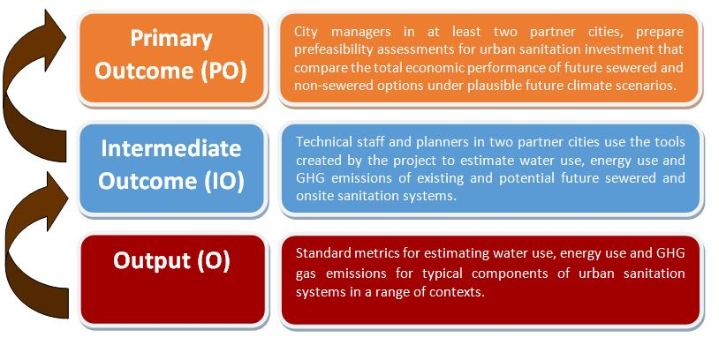
Cactus
Developed by: | University of Leeds
Year of development: | 2017
Tool format: | Excel Workbook format, available online for free. Click here.
Waste streams covered: | Wastewater
Value chain segment: | Containment, Collection and Conveyance, Treatment, Disposal and Reuse.
Primary users: | Researchers, Consultants and Development partners supporting Gov. stakeholders in decision making, Donors.
About the Tool:
CACTUS aims to improve the quality of information available to decision makers who seek to make investment decisions relating to urban sanitation provision in cities and towns.
CACTUS works on the principle that there is never a single ‘best’ solution to the question of how to provide effective, equitable and sustained sanitation – the decision will be driven by a variable number of factors, and that different cities and towns and indeed different stakeholders in a given city or town, would place different levels of emphasis on different factors.
Reference materials: Click here
Data Requirement: Cost estimates for a range of sanitation service delivery options
Training Resources: http://cactuscosting.com

Slide 30
CWIS Measurement Tool
Developed by: | Athena Infonomics and BMGF
Year of development: | 2020
Tool format: | Online dashboard with indicators, can be accessed from here.
Waste streams covered: | Wastewater
Value chain segment: | User interface, Collection and Conveyance, Treatment, Disposal and Reuse.
Primary users: | Consultants, researchers and decision makers.
About the Tool:
Citywide Inclusive Sanitation (CWIS) is a public service approach to advance Equitable, Safe, and Sustainable outcomes, by strengthening core public system functions of Responsibility, Accountability, and Resource Planning and Management.
The CWIS dashboard is designed to help the CWIS city grantees monitor and track their progress from their baselines and quickly see how their peers are performing on similar metrics.
Data Requirement:
Indicators helping track fairness in service delivery in terms of service quality, prices, and deployment of public finance/subsidies. Indicators capturing how the waste generated is being safely managed, and assess whether the services safeguard customers, workers, and communities from safety and health risks by reaching everyone with safe sanitation. Indicators capturing how services are reliably and continually delivered based on effective management of human, financial and natural resources. Indicators helping capture the enabling environment looking at how responsibilities are structured, who is responsible for delivering services, who are they accountable to? how are resources planned and allocated?
Resource materials: Click here to access CWIS Indicators’ Methodology Note; Click here to access CWIS Measurement Note; Click here to access CWIS Measurement Note.
Case Study: Wai, Warangal, Narsapur, Trichy, Khulna, Kampala, Lusaka, Dakar.

Slide 31
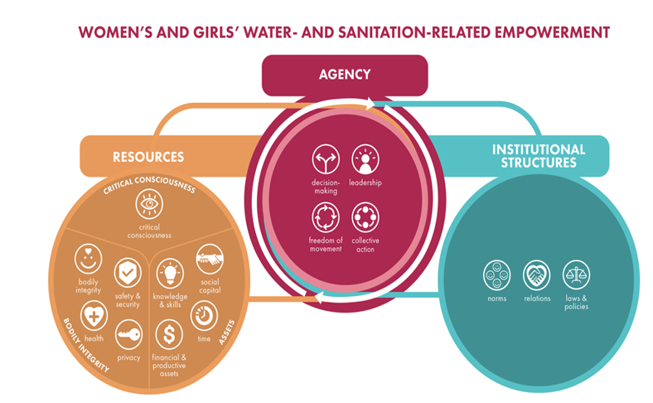
MUSE
Developed by: | Emory University
Year of development: | 2019
Tool format: | Excel based tool, with indicators, which can be accessed from here.
Waste streams covered: | Wastewater
Value chain segment: | User interface, Collection and Conveyance, Treatment, Disposal and Reuse.
Primary users: | Consultants, researchers and decision makers.
About the Tool:
MUSE sanitation tool is a set of scales and indices that measure women's empowerment in the context of urban sanitation, across four domains: Access and decision-making, safety and dignity, knowledge and agency, and voice and collective action.
The Goal of the MUSE tool is to create and validate survey tools to measure women’s sanitation-related empowerment in urban areas, for (a) program design; and
(b) monitoring and evaluation.
Resource materials: Table of definitions; A systematic review of women’s empowerment in sanitation; Development and validation of measurement framework; Protocol for development and validation of instruments for MUSE
Data Requirement: Access to sanitation infrastructure, Sanitation related knowledge, attitude and practices. Further, the tool also requires data related to -
Participation in decision-making about sanitation
Safety and security when using sanitation facilities
Freedom from stigma and discrimination related to sanitation

Slide 32
Sanitation Decision Support Tool (Akvopedia)
Developed by: | AKVO
Year of development: | 2007
Tool format: | Web-based tool platform, available online for free
Waste streams covered: | Water and Sanitation
Value chain segment: | User Interface, Containment, Collection and Conveyance, Treatment, Disposal and Reuse.
Primary users: | WASH practitioners, policymakers, and donors.
About the Tool :
The Sanitation Decision Support Tool (Akvopedia) is a web-based tool that helps users to assess the sanitation needs of a community and to develop appropriate interventions. It is developed and maintained by Akvo, a non-profit organization that provides open-source tools and resources for water and sanitation practitioners.
The tool covers a wide range of sanitation topics, including:
Sanitation needs assessment: The tool helps users to collect and analyze data on the sanitation situation in a community, including the types of sanitation facilities used, the level of access to sanitation, and the associated health risks.
Sanitation intervention planning: The tool helps users to develop and evaluate different sanitation interventions, taking into account factors such as cost, technical feasibility, and social acceptability.
Sanitation monitoring and evaluation: The tool helps users to track progress towards achieving sanitation goals and to identify areas where interventions need to be adjusted.
Data Requirements:
The web portal has serval supporting tools covering broad topics like, Water, Rainwater Harvesting, Sanitation, Finance, Sustainability Decision & other Assessment Tools.
Some of the tools related to sanitation include the WASH in Schools Assessment tool, SSWM Toolbox, The WASH Performance Index Report, etc.
The tools can be accessed from website.

Slide 33
Thank you
www.athenainfonomics.com

